Slide 1


MS Word

Slide 2

MS Word

Slide 3

MS Word

Slide 4

MS Word

Slide 5
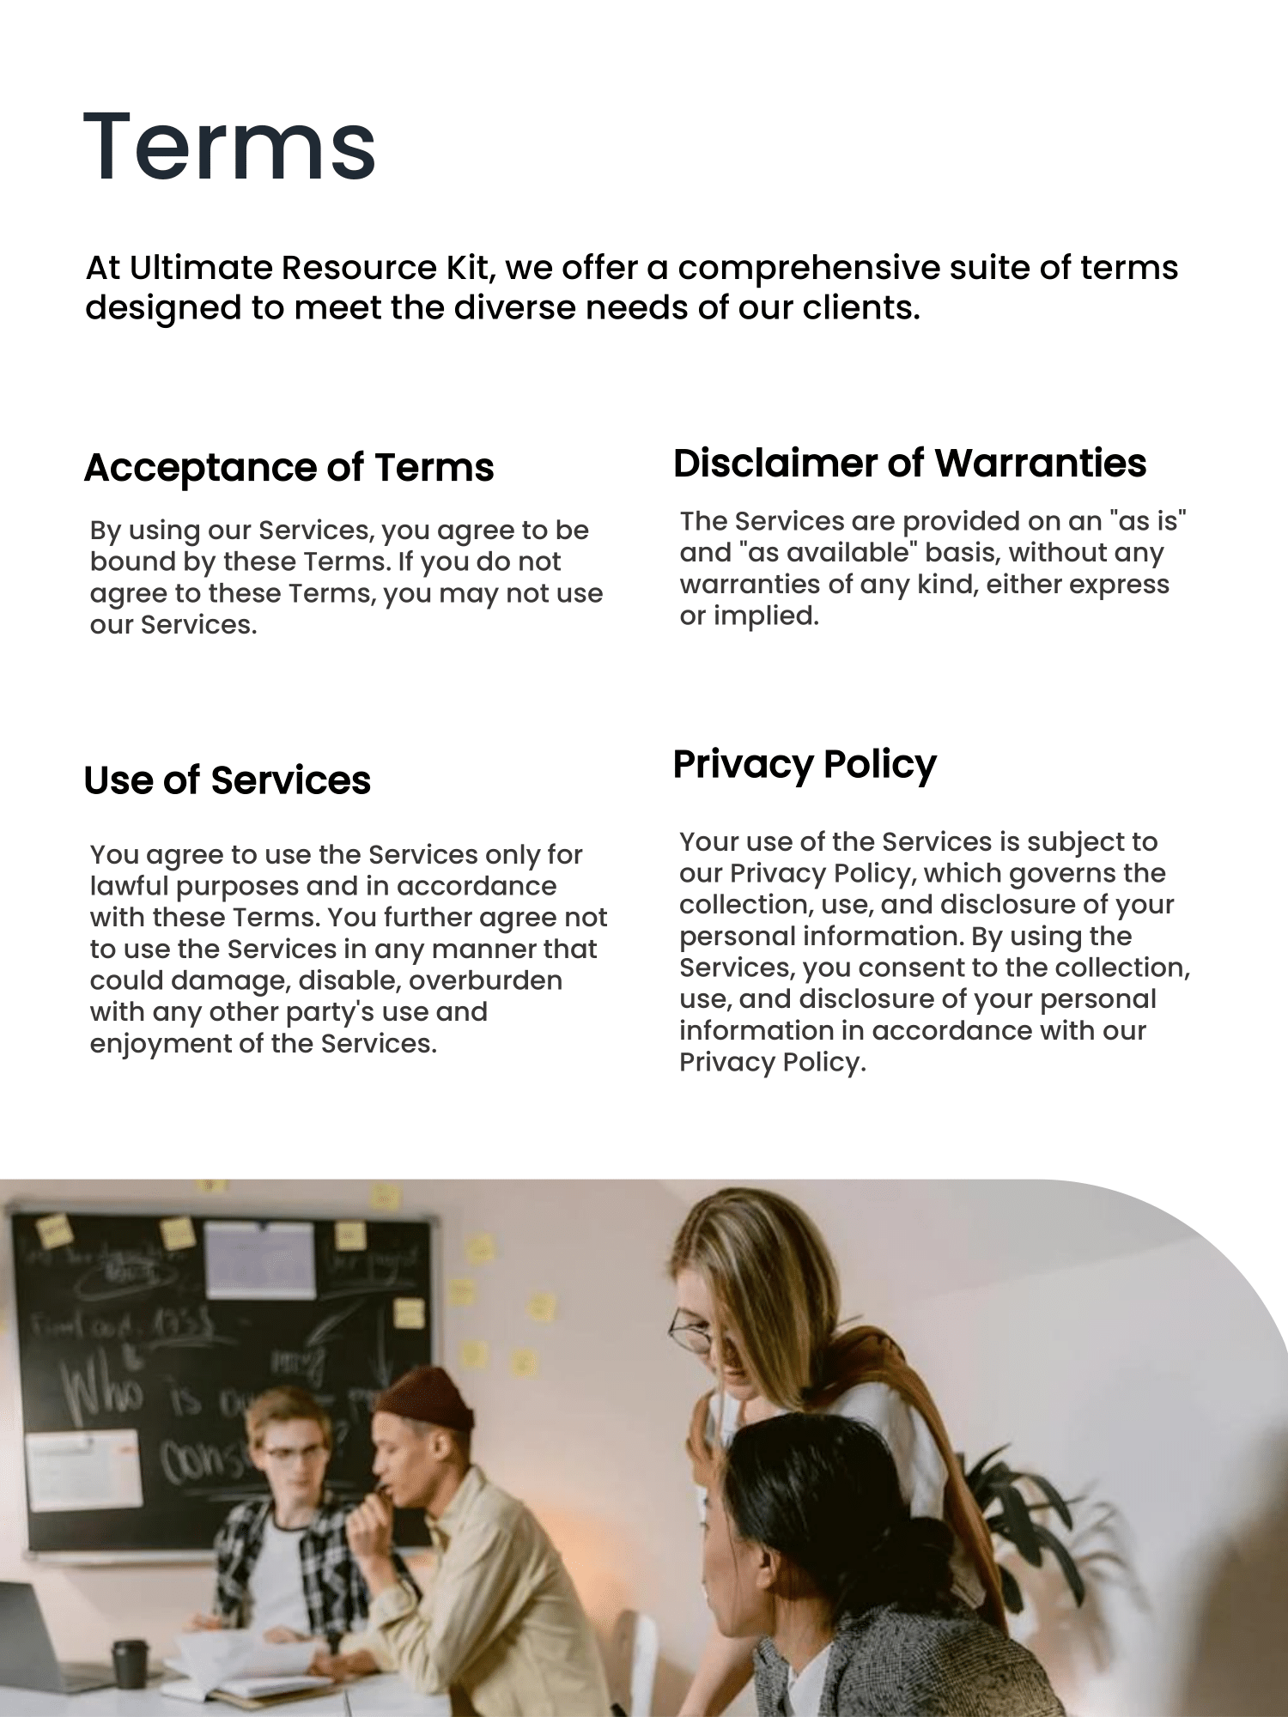
MS Word

Slide 6
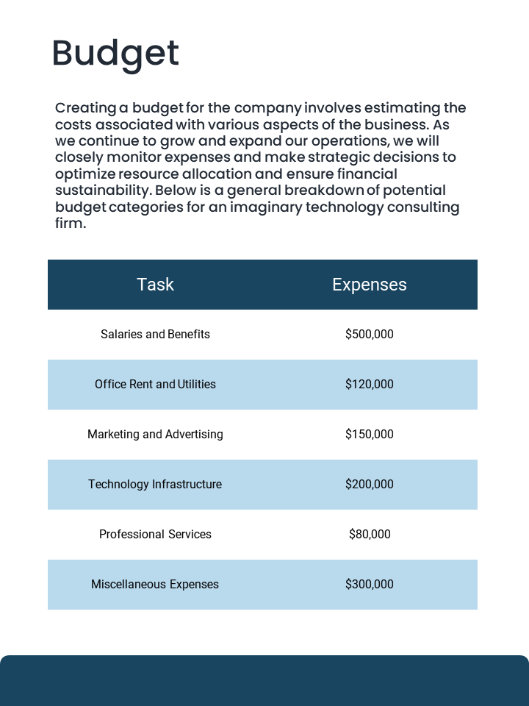
MS Word

Slide 8

Fully Customizable
MS PowerPoint Document

Slide 9
1
Receive Template In Your Inbox
Files will be sent to your email instantly
Lifetime Access
2
Download – Lifetime Access
Download the file on your Apple or Windows device that supports MS office.
3
Customize
Change your logo, colors, text and to complete your document

